Slide 1
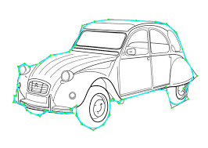
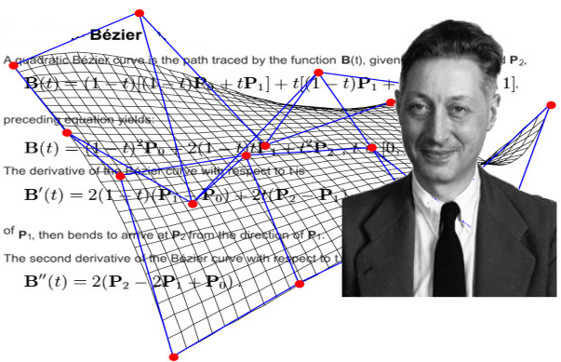
Spline : A spline is a flexible strip that passes thru a designated control points.
Bezier Curve
- Pierre Bezier
- Makes use of Bernstein polynomials
- Used in 1960s for designing curves for the bodywork of Renault cars.
- Bezier curves are commonly found in painting and drawing packages, as well as
CAD system, for generating Computer fonts and animation

Slide 2

Spline : A spline is a flexible strip that passes thru a designated control points.
P₁(x₁,y₁)
P₁(x₁,y₁)
u₁
u₂
P₃(x₃,y₃)
P₃(x₃,y₃)
u₅
u₀
u₃
u₄
Bezier Curve
The above figure shows a smooth curve comprising of a large number of very small line segments. For understanding the concept to draw such a line we deal with a curve as show above which is an approximation of the curve with five line segments only
The approach below is used to draw a curve for any number of control points
n = number of control points -1 is its order (n = 1 for linear, 2 for quadratic, etc.)
Suppose P_{0,}P_{1,}P_{2,}P₃ are four control points (n = 3 Cubic Bezier Curve)
Number of segments in a line segment : nSeg (= 5 say)
i = 0 to nSeg
u = i/nSeg [0,1] 0 <= u <= 1
u₀ = 0/5 u₁ = 1/5 u₂ = 2/5 u₃ = 3/5 u₄ = 4/5 u₅ = 5/5
x(u) =$\sum_{j=0}^{n}{x_{j} {BEZ}_{j,n}(u)}$ n (order) : number of control points - 1
x(u) = x₀ BEZ_{0,3}(u) + x₁ BEZ_{1,3}(u) + x₂ BEZ_{2,3}(u) + x₃ BEZ_{3,3}(u)
Similarly
y(u) =$\sum_{j=0}^{n}{y_{j} {BEZ}_{j,n}(u)}$ n (order) : number of control points - 1
y(u) = y₀ BEZ_{0,3}(u) + y₁ BEZ_{1,3}(u) + y₂ BEZ_{2,3}(u) + y₃ BEZ_{3,3}(u)
P₀(x₀,y₀)
P₀(x₀,y₀)
P₂(x₂,y₂)
P₂(x₂,y₂)

Slide 3
Spline : A spline is a flexible strip that passes thru a designated control points.
P₁(x₁,y₁)
P₁(x₁,y₁)
u₁
u₂
P₃(x₃,y₃)
P₃(x₃,y₃)
u₅
x(u) = x₀ BEZ_{0,3}(u) + x₁ BEZ_{1,3}(u) + x₂ BEZ_{2,3}(u) + x₃ BEZ_{3,3}(u)
y(u) = y₀ BEZ_{0,3}(u) + y₁ BEZ_{1,3}(u) + y₂ BEZ_{2,3}(u) + y₃ BEZ_{3,3}(u)
The Bezier blending function BEZ_{j,n} (u) is defined as,
BEZ_{j,n} (u) = n! u^{j} (1-u)^{n-j}
j! (n-j)!
BEZ_{j,n} (u) = C_{(n,j)} u^{j} (1-u)^{n-j} Where C_{(n,j)} is the Binomial Coefficient
C_{(n,j)} = n!
j! (n-j)!
Blending Function
Control Points
Convex Hall
u₀
u₃
u₄
P₀(x₀,y₀)
P₀(x₀,y₀)
P₂(x₂,y₂)
P₂(x₂,y₂)

Slide 4
Spline : A spline is a flexible strip that passes thru a designated control points.
P₁(x₁,y₁)
P₁(x₁,y₁)
u₁
u₂
P₃(x₃,y₃)
P₃(x₃,y₃)
u₅
u₀
u₃
u₄
P₀(x₀,y₀)
P₀(x₀,y₀)
P₂(x₂,y₂)
P₂(x₂,y₂)
For each ‘u’ the coordinates x and y are computed and desired curve is produced when the adjacent coordinates (x,y) are connected with a straight line segment
x(u) = x₀ BEZ_{0,3}(u) + x₁ BEZ_{1,3}(u) + x₂ BEZ_{2,3}(u) + x₃ BEZ_{3,3}(u)
y(u) = y₀ BEZ_{0,3}(u) + y₁ BEZ_{1,3}(u) + y₂ BEZ_{2,3}(u) + y₃ BEZ_{3,3}(u)
Now
Q(u) = P₀ BEZ_{0,3}(u) + P₁ BEZ_{1,3}(u) + P₂ BEZ_{2,3}(u) + P₃ BEZ_{3,3}(u)
Four blending functions must be found based on Bernstein Polynomials
BEZ_{0,3} (u) = 3! u⁰ (1-u)³ = (1-u)³ BEZ_{1,3} (u) = 3! u¹ (1-u)² = 3u (1-u)²
0! 3! 1! 2!
BEZ_{2,3} (u) = 3! u² (1-u) = 3u² (1-u) BEZ_{3,3} (u) = 3! u³ (1-u)⁰ = u³
2! 1! 3! 0!
Normalizing properties apply to blending functions, that means they all add up to one
Substituting these functions in above equation
Q(u) = (1-u)³ P₀ + 3u (1-u)² P₁ + 3u² (1-u) P₂ + u³ P₃
When u = 0 then Q(u) = P₀ and when u =1 then Q(u) = P₃

Slide 5
Spline : A spline is a flexible strip that passes thru a designated control points.
P₁(x₁,y₁)
P₁(x₁,y₁)
u₁
u₂
P₃(x₃,y₃)
P₃(x₃,y₃)
u₅
u₀
u₃
u₄
P₀(x₀,y₀)
P₀(x₀,y₀)
P₂(x₂,y₂)
P₂(x₂,y₂)
Q(u) = (1-u)³ P₀ + 3u (1-u)² P₁ + 3u² (1-u) P₂ + u³ P₃
P₀
in Matrix Form P₁
Q(u) = [(1-u)³ 3u (1-u)² 3u² (1-u) u³ ] P₂
P₃
P₀
or P₁
Q(u) = [(1-3u +3u² –u³) (3u-6u² +3u³) (3u² –3u³) u³] P₂
P₃
-1 3 -3 1 P₀
or 3 -6 3 0 P₁
Q(u) = [u³ u² u¹ 1] -3 3 0 0 P₂
1 0 0 0 P₃

Slide 6
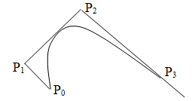
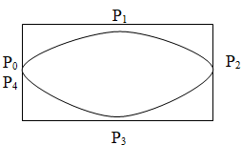
Properties of a Bezier Curve
1. Bezier curve lies in the convex hull of the control points which ensure that the curve smoothly follows the control Points
2. Four Bezier polynomials are used in the construction of curve to fit four control points
3. It always passes thru the end points (first and last control points)
4. Closed curves can be generated by specifying the first and last control points at the same position
5. Specifying multiple control points at a single position gives more weight to that position
6. Complicated curves are formed by piecing several sections of lower degrees together
7. The tangent to the curve at an end point is along the line joining the end point to the adjacent control point

Slide 7
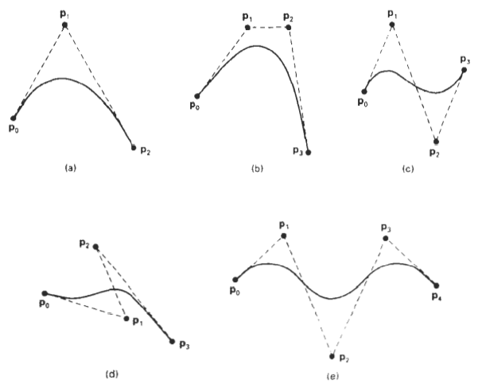
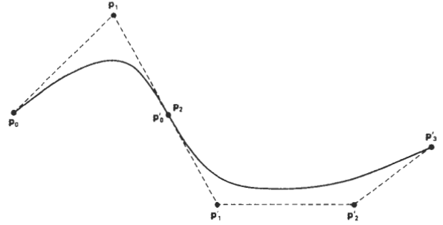

Slide 8

Bezier surfaces (Non Planar Surfaces)
To create a Bézier surface, We blend a mesh of Bézier curves using the blending function
where j and k are points in parametric space and represents the location of the knots in real space. The Bézier functions specify the weighting of a particular knot. They are the Bernstein coefficients. The definition of the Bézier functions is
where C(n,k) represents the binary coefficients. When u=0, the function is one for k=0 and zero for all other points.
When we combine two orthogonal parameters, we find a Bézier curve along each edge of the surface, as defined by the points along that edge.
Bézier surfaces are useful for interactive design and were first applied to car body design.
The properties of Bezier surfaces are controlled by the blending functions
- The surface takes the general shape of the control points
- The surface is contained within the convex hull of the control points
- The corners of the surface and the corner control vertices are coincident

Slide 9
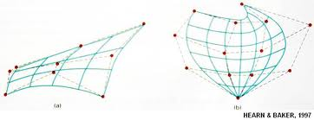
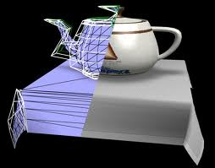

Slide 10
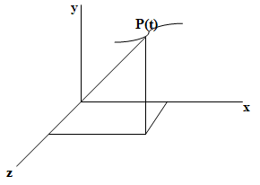
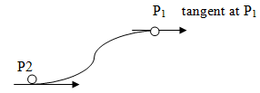
Parametric Cubic Curve
3
A parametric cubic curve is defined as P(t) = ∑ a_{i} t^{i} 0 <= t <= 1 ------ (i)
i =0
where, P(t) is a point on the curve
Expanding equation (i) yields
P(t) = a₃t³ + a₂t² + a₁t + a₀ ------------------------------(ii)
This equation is separated into three components of P(t)
x(t) = a_{3x}t³ + a_{2x}t² + a_{1x}t + a_{0x}
y(t) = a_{3y}t³ + a_{2y}t² + a_{1y}t + a_{0y}
z(t) = a_{3z}t³ + a_{2z}t² + a_{1z}t + a_{0z} ------------------------------(iii)
To solve (iii), twelve unknown coefficients a_{ij} (algebraic coefficients) must be specified
From known end point coordinates of each segment, six of twelve needed equations are obtained.
The other six are found by using tangent vectors at the two ends of each segment
Direction of tangent vectors establishes slopes(direction cosines) of curve at end points
This procedure for defining a cubic curve using end points and tangent vector is one form of Hermite Interpolation

Slide 11
P(t) = a₃t³ + a₂t² + a₁t + a₀ ------------------------------(ii)
Each cubic curve segment is parameterized from 0 to 1 so that known end points correspond to the limit values of the parametric variable t, that is P(0) and P(1)
Substituting t = 0 and t = 1 the relation ship between two end point vectors and the algebraic coefficients are found
P(0) = a₀ ₃P(1) = 3a₃ + 3a₂ + 3a₁ + 3a₀
P’(1) = 3a₃ + 2a₂ + a₁
3P(1) - P’(1) = a₂ +2a₁ +3a₀
To find the tangent vectors equation ii must be differentiated with respect to t
P’(t) = 3a₃t² + 2a₂t + a₁
The tangent vectors at the two end points are found by substituting t = 0 and t = 1 in this equation
P’(0) = a₁ P’(1) = 3a₃ + 2a₂ + a₁
The algebraic coefficients ‘a_{i}‘ in equation (ii) can now be written explicitly in terms of boundary conditions – endpoints and tangent vectors
a₀ = ? a₁ = ?
a₂ = ? a₃ = ?

Slide 12
The algebraic coefficients ‘a_{i}‘ in equation
P(t) = a₃t³ + a₂t² + a₁t + a₀ ------------------------------(ii)
can now be written explicitly in terms of boundary conditions – endpoints and tangent vectors
a₀= P(0) a₁= P’(0)
a₂= -3 P (0) + 3 P (1) -2 P’(0) - P’(1) a3= 2 P (0) - 2 P (1) + P’(0) + P’(1)
Substituting these values of ‘a_{i}‘ in equation (ii) and rearranging the terms yields
P(t) = (2t³ - 3t² + 1) P(0) + (-2t³ + 3t²) P(1) + (t³ - 2t² + t) P’(0)+ (t³ - t² ) P’(1)
By varying parameter t in these blending function from 0 to 1 several points on curve segments can be found
P(0), P(1), P’(0), P’(1): geometric coefficients, represent known vector quantities
Polynomial coefficients of vector quantities: blending functions

Slide 13
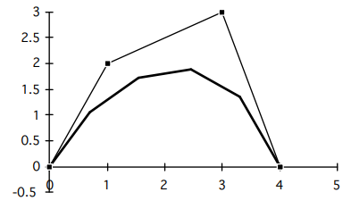
Calculate (x,y) coordinates of Bézier curve described by the following 4 control points: P₀(0,0), P₁(1,2), P₂(3,3), P₃(4,0) with 5 line segments
For four control points, n = 3. = no of control points -1
1. Calculate all the blending functions, BEZ_{j,n} for j = 0, . . ,n using the formula:
BEZ_{j,n} (u) = n! u^{j} (1-u)^{n-j}
j! (n-j)!
BEZ_{0,3} (u) = (1-u)³ = BEZ_{1,3} (u) = 3u (1-u)² =
BEZ_{2,3} (u) = 3u² (1-u) = BEZ_{3,3} (u) = u³
2. Calculate the points on the curve.
x(u) = x₀ BEZ_{0,3}(u) + x₁ BEZ_{1,3}(u) + x₂ BEZ_{2,3}(u) + x₃ BEZ_{3,3}(u)
y(u) = y₀ BEZ_{0,3}(u) + y₁ BEZ_{1,3}(u) + y₂ BEZ_{2,3}(u) + y₃ BEZ_{3,3}(u)
u₀ = 0/5 =0 x(0.0) = 0 u₃ =3/5= 0.6 x(0.6)= 1.55
y(0.0) = 0 y(0.6) = 1.7
u₁ = 1/5=0.2 x(0.2) = 0. (1-0.2)³+ 1. 3.0.2 (1-0.2)² + 3. 3.0.2² (1-0.2) + 4.0.2³ = 0.6
y(0.2) = 0. (1-0.2)³+ 2. 3.0.2 (1-0.2)² + 3. 3.0.2² (1-0.2) + 0.0.2³ = 1.34
u₂ = 2/5=0.4 x(0.4) = 1.5
y(0.4)= 1.7
u₃ = 1/5=0.6 x(0.6) = 2.45
y(0.6)= 1.9
u₄ = 4/5=0.8 x(0.8) = 3.3
y(0.8) = 1.3
u₅ = 5/5=1 x(1) = 4 y(0.4) = y(1) = 0
P₂
P₁
u₃
u₂
u₄
u₁
u₀
u₅
P₀
P₃

Slide 14
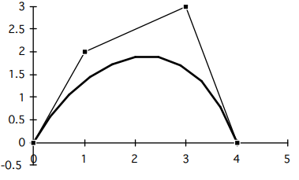
Calculate (x,y) coordinates of Bézier curve described by the following 4 control points: (0,0), (1,2), (3,3), (4,0) with 11 line segments
For four control points, n = 3.
1. Calculate all the blending functions, BEZ_{j,n} for j = 0, . . ,n using the formula:
BEZ_{j,n} (u) = n! u^{j} (1-u)^{n-j}
j! (n-j)!
BEZ_{0,3} (u) = (1-u)³
BEZ_{1,3} (u) = 3u (1-u)²
BEZ_{2,3} (u) = 3u² (1-u)
BEZ_{3,3} (u) = u³
2. Calculate the points on the curve.
u = 0 x(0) = u = x( ) =
y(0) = y( ) =
u = x( ) = u = x( ) =
y( ) = y( ) =
u = x( ) = u = 1 x( 1) =
y( ) = y(1) =

